Slide 1
Machine Learning
Linear Regression

Slide 2




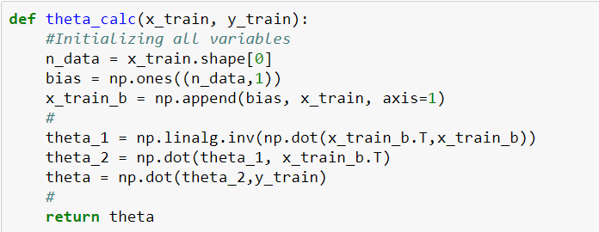
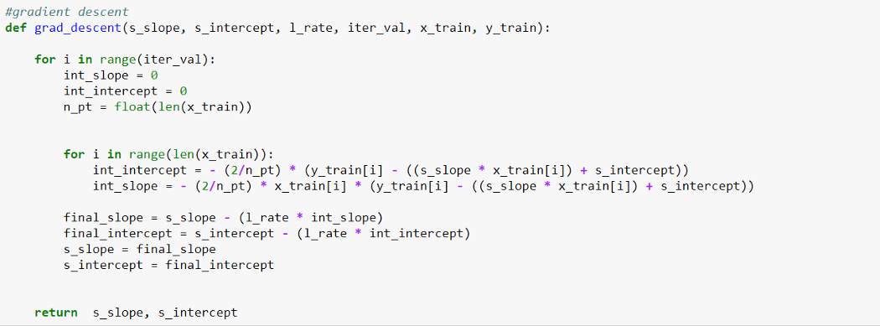
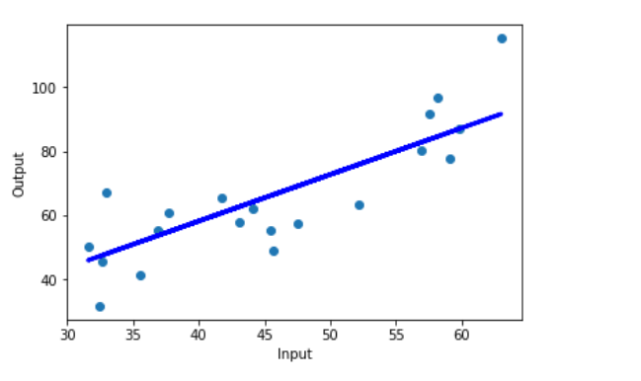
What is Regression?
Regression
A supervised algorithm that learns from a set of training samples.
Each training sample has one or more input values and a single output value.
The algorithm learns the line, plane or hyper-plane that best fits the training samples.
Prediction
Use the learned line, plane or hyper-plane to predict the output value for any input sample.

Slide 3
Linear regression makes predictions/forecast for continuous/real or numeric variables such as sales, salary, age, product price, etc.
Linear regression algorithm shows a linear relationship between a dependent (y) and one or more independent (x) variables, hence called as linear regression.
Since linear regression shows the linear relationship, which means it finds how the value of the dependent variable is changing according to the value of the independent variable.

Slide 4
Simple Linear Regression Form
Y= θ₀ + θ₁ X
Y= Dependent Variable (Target Variable) X= Independent Variable (predictor Variable) θ₀ = intercept of the line (Gives an additional degree of freedom) θ₁= Linear regression coefficient (scale factor to each input value). The values for x and y variables are training datasets for Linear Regression model representation.

Slide 5
Regression Coefficients
When performing simple linear regression, the four main components are:
Dependent Variable — Target variable / will be estimated and predicted
Independent Variable — Predictor variable / used to estimate and predict
Slope — Angle of the line / denoted as m or 𝛽1 or a
Intercept — Where function crosses the y-axis / denoted as 𝑐 or 𝛽0

Slide 6
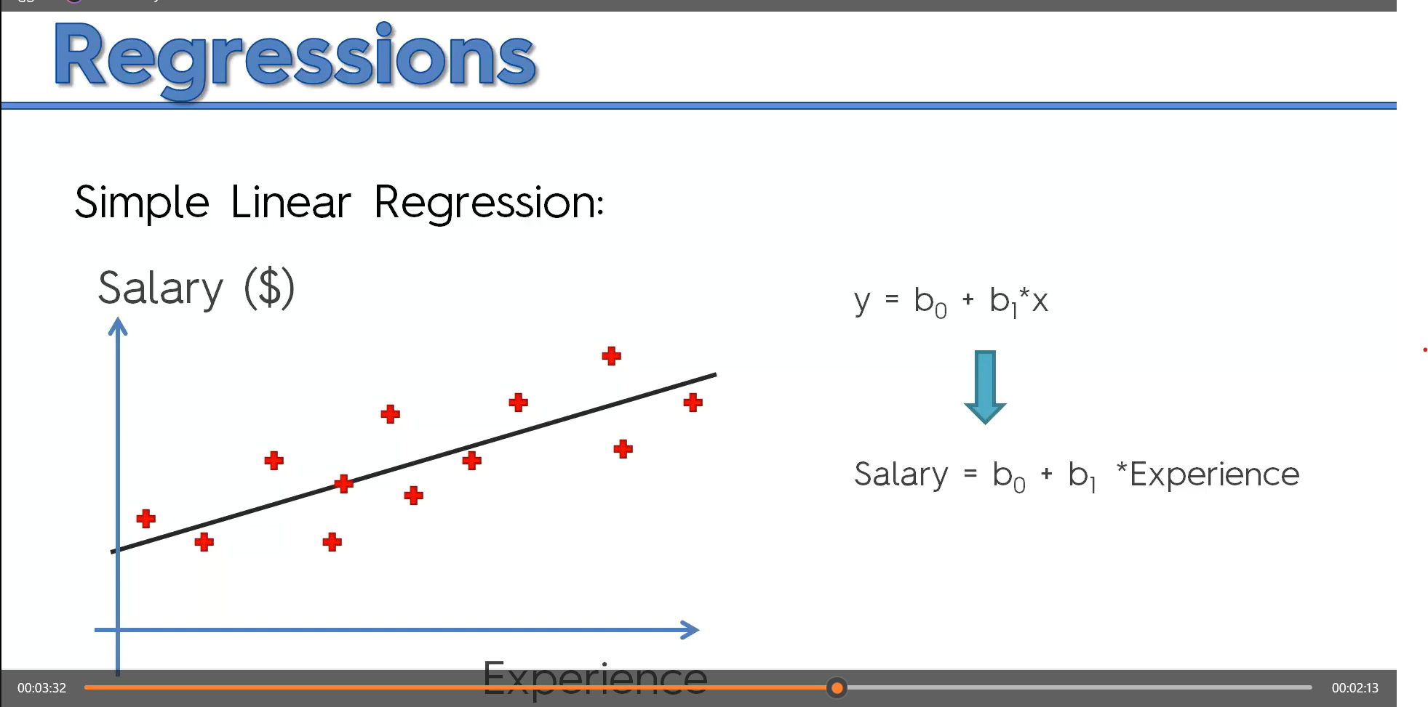
Salary= θ₀ + θ_{1 *} Experience

Slide 7
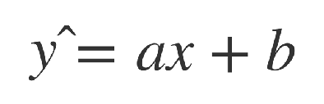

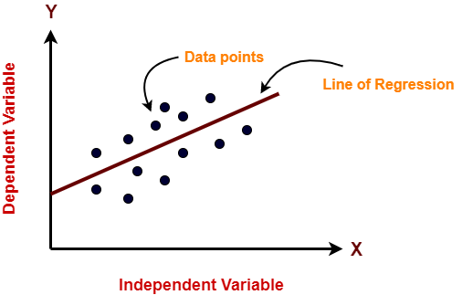
Simple (Single Dimension) Linear Regression
Single dimension linear regression has pairs of x (independent variable) and y (dependent variable) values as input training samples. ŷ is the predicted value.
It uses these training sample to derive a line that predicts values of y.
The training samples are used to derive the values of a and b that minimise the error between actual value (y) and predicated values (ŷ )

Slide 8
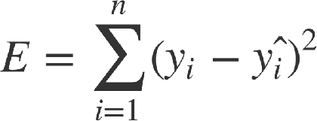
Simple Linear Regression
We want a line that minimises the error between the y values in training samples and the y values that the line passes through.
Or put another way, we want the line that “best fits’ the training samples.
So we define the error function for our algorithm so we can minimise that error.

Slide 9
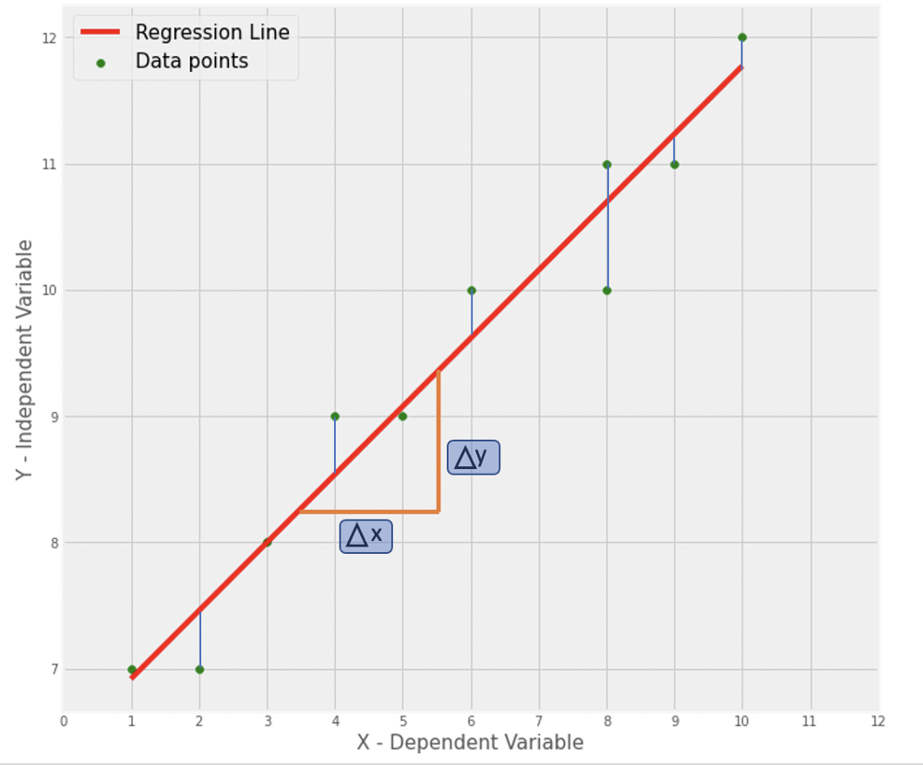
When we have drawn the “best fit line” we are ready to make some predictions.
However, since our prediction is based on the parameter values we estimate, when we predict new y values given x, we will have error or vertical offset (blue lines).
This error is denoted as |𝑦̂ −𝑦| where 𝑦̂ is on our regression line and y is the actual observed value (green dot).

Slide 10
Real-life example
Given:-We have a dataset which contains information about relationship between ‘number of hours studied’ and ‘marks obtained’. Many students have been observed and their hours of study and grade are recorded. This will be our training data.
Goal: to design a model that can predict marks if given the number of hours studied. Using the training data, a regression line is obtained which will give minimum error. This linear equation is then used for any new data.
That is, if we give number of hours studied by a student as an input, our model should predict their mark with minimum error.

Slide 11
Y(pred) = ŷ= θ₀ + θ₁*x
The values θ₀ and θ₁ must be chosen so that they minimize the error. If sum of squared error is taken as a metric to evaluate the model, then goal to obtain a line that best reduces the error.

Slide 12


Performance Metrics
1. Mean Squared Error (MSE)
The most common metric for regression tasks is MSE. It is the average of the squared difference between the predicted and actual value.
2. Mean Absolute Error (MAE)
This is simply the average of the absolute difference between the target value and the value predicted by the model. Not preferred in cases where outliers are prominent.

Slide 13
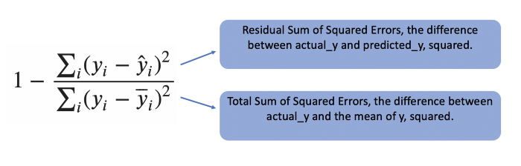
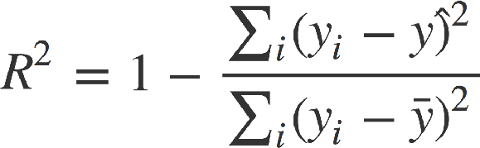
3. R-squared
The R-Squared measure can be used to determine a how well a model
fits the data. This measure is also known as the Coefficient of Determination.
It determines how much of the total variation in Y is explained by the variation in X.

Slide 14
the performance of linear regression models is evaluated with R² — which gives a value between 0 and 1, and the higher the R² the better the model.

Slide 15
A value of 1 indicates a perfect fit.
A value of 0 indicates a fit that is no better than simply predicting the mean of the input y values.
A negative value indicates a fit that is even worse than just predicting the mean of the input y values.

Slide 16
Multiple Linear Regression
Multiple regression goes one step further, and instead of one, there will be two or more independent variables.
If we have an additional variable (let’s say “education”) in the previous question then it becomes a multiple regression:
Income= b0+ b1*Experience+ b2*Education

Slide 17
Real –life example
prediction of used-car prices based on make, model, year, milage and color
[make, model, year, milage, color ] → car prices
prediction of the price for a house in the market based on location, lot size, number of beds, number of baths, neighborhood characteristics etc.
[location, lot size, # beds, # bath, crime rate, school ratings] → house prices

Slide 18
For multiple linear regression, the form of the model is-
y = θ₀ + θ₁x₁ + θ₂x₂ + θ₃x₃ + …… + θ_{n}x_{n}
Y =θ^{T}X
Here,
θ and X are Column vectors
θ is the model’s parameter vector, containing the bias term θ ₀ and the feature weights θ ₁to θ _{n}.
Y is a dependent variable.
• n is the number of features.
• x_{i} is the i^{th} feature value.
x₁, x₂, …., x_{n} are independent variables.
θ _{j} (1<=j<=n) is the slope or weight that specifies the factor by which x_{j} has an impact on Y.

Slide 19
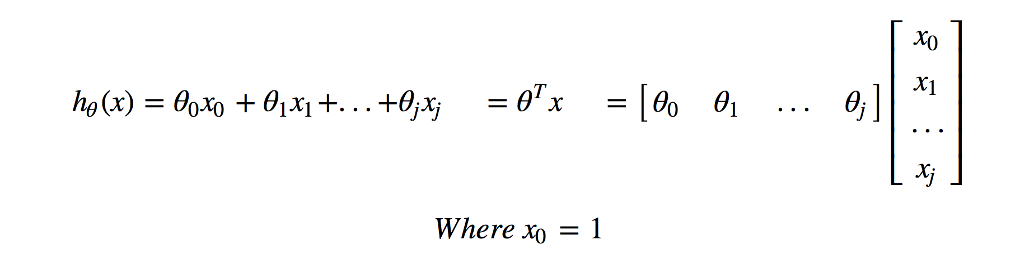

Slide 20
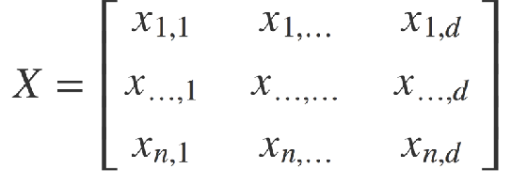
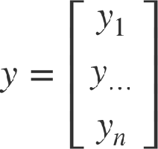
Multiple Linear Regression
Each training sample has an x made up of multiple input values and a corresponding y with a single value.
The inputs can be represented as an X matrix in which each row is sample and each column is a dimension.
The outputs can be represented as y matrix in which each row is a sample.

Slide 21
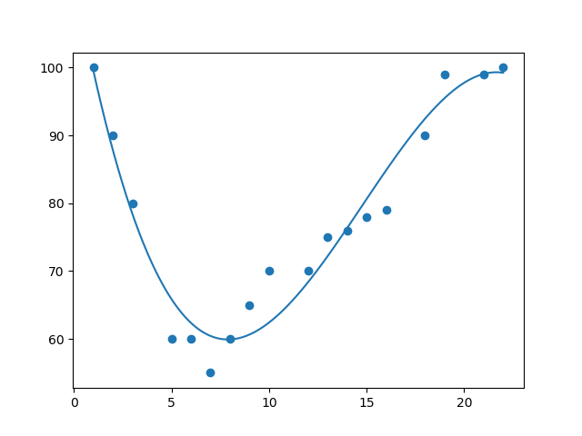
Polynomial Regression
If data points clearly do not fit a linear regression (a straight line through all data points), it might be ideal for polynomial regression.
Polynomial regression, like linear regression, uses the relationship between the variables x and y to find the best way to draw a line through the data points.

Slide 22
Polynomial Regression is a regression algorithm that models the relationship between a dependent(y) and independent variable(x) as nth degree polynomial. The Polynomial Regression equation is given below:
y= b₀+b₁x₁+ b₂x₁²+ b₃x₁³+...... b_{n}x₁^{n}
The dataset used in Polynomial regression for training is of non-linear nature.
It makes use of a linear regression model to fit the complicated and non-linear functions and datasets.

Slide 23
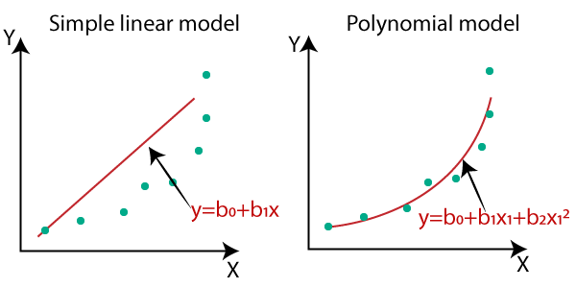

Slide 24
Equation of the Polynomial Regression Model:
Simple Linear Regression equation: y = b₀+b₁x .........(a)
Multiple Linear Regression equation: y= b₀+b₁x+ b₂x₂+ b₃x₃+....+ b_{n}x_{n} .........(b)
Polynomial Regression equation: y= b₀+b₁x + b₂x²+ b₃x³+....+ b_{n}x^{n} ..........(c)

Slide 25
Assumptions of Linear Regression
In linear regression, the dependent variable is the outcome or result from you're trying to predict. The independent variables are the things that explain your dependent variable.
You can use them to build a model that accurately predicts your dependent variable from the independent variables.
For the model to be reliable and valid, there are some essential requirements:
The independent and dependent variables are linearly related.
There is no strong correlation between the independent variables.
Observations should be independent of one another.

Slide 26
Gradient Descent

Slide 27
Gradient Descent
Gradient descent is an optimization algorithm used in linear regression to find the best-fitting line by minimizing the cost function, typically the Mean Squared Error (MSE)
In gradient descent we pick a random set of weights for our algorithm and iteratively adjust those weights in the direction of the gradient of the error with respect to each weight.
As we iterate, the gradient approaches zero and we approach the minimum error.
In machine learning we often use gradient descent with our error function to find the weights that give the lowest errors.

Slide 28
Machine learning uses derivatives in optimization problems. Derivatives are used to decide whether to increase or decrease the weights to increase or decrease an objective function.
If we can compute the derivative of a function, we know in which direction to proceed to minimize it.

Slide 29


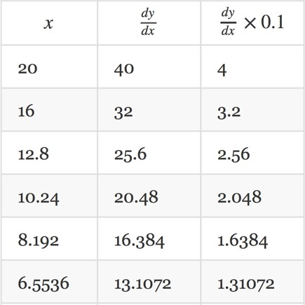
Gradient Descent
Here is an example with a very simple function:
The gradient of this function is given by:
We choose an random initial value for x and a learning rate of
0.1 and then start descent.
On each iteration our x value is decreasing and the gradient (2x) is converging towards 0.

Slide 30
Gradient Descent
The learning rate is a what is know as a hyper-parameter.
If the learning rate is too small then convergence may take a very long time.
If the learning rate is too large then convergence may never happen because our iterations bounce from one side of the minima to the other.
Choosing a suitable value for hyper-parameters is an art so try diﬀerent values and plot the results until you find suitable values.

Slide 31
Cost Function of Linear Regression using gradient Descent
Remember the hypothesis of linear regression is:

Slide 32
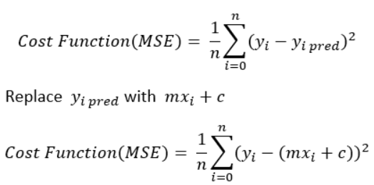
Cost Function of Linear Regression using gradient Descent

Slide 33
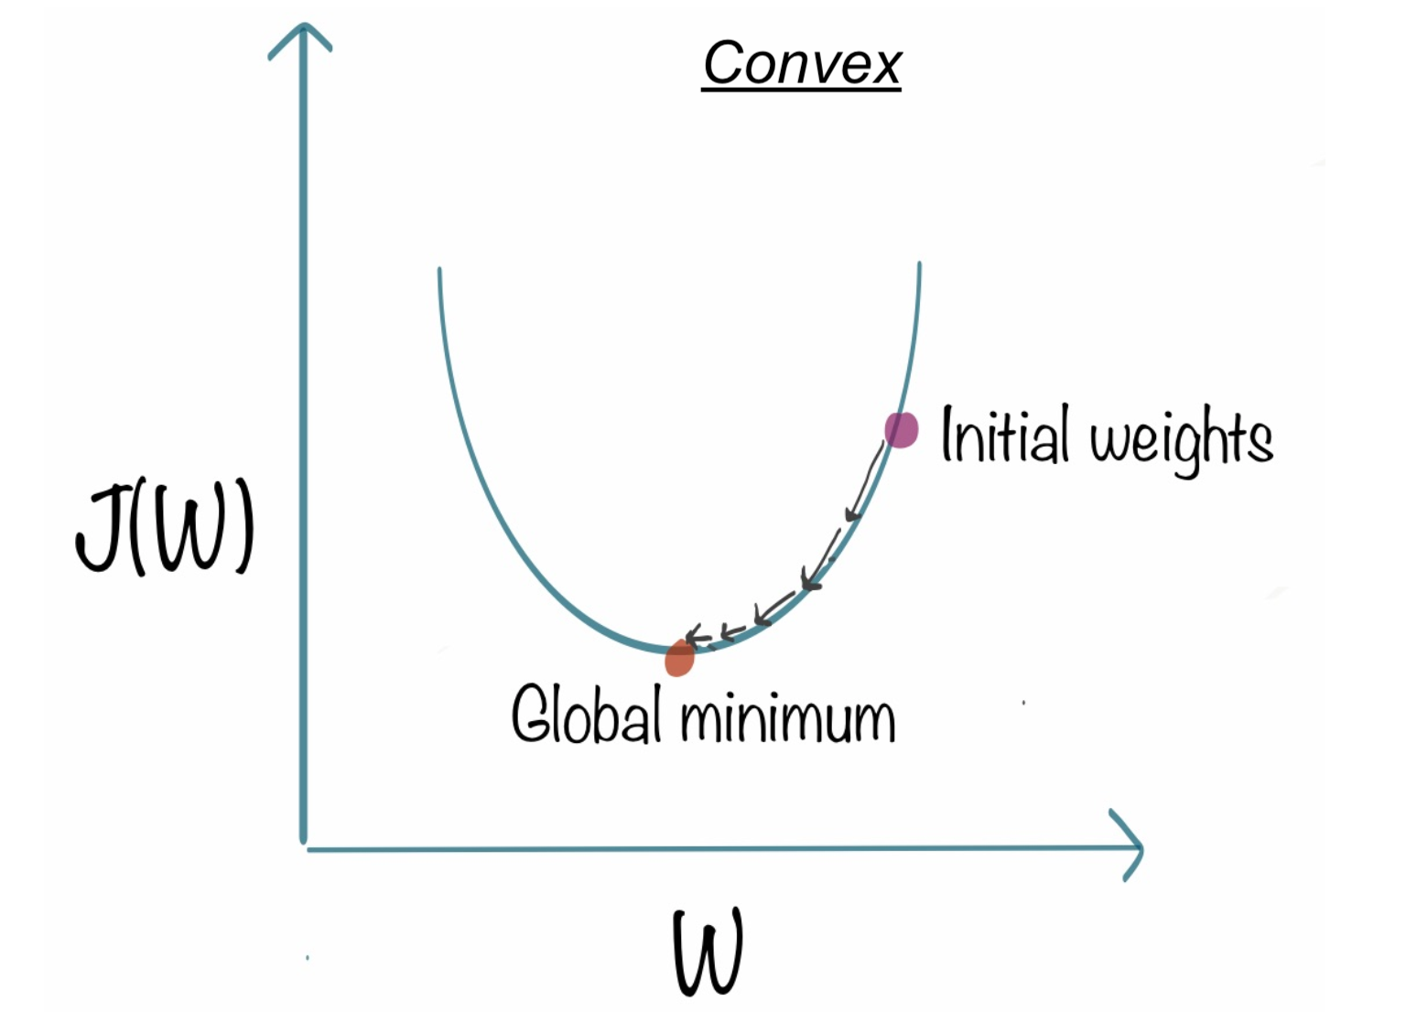
Linear regression uses Least Squared Error as loss function that gives a convex graph and
then we can complete the optimization by finding its vertex as global minimum.
Gradient Descent basically just does what we were doing by hand —
change the theta values, or parameters, bit by bit, until we hopefully arrived a minimum.

Slide 34
In calculus, partial derivatives represent the rate of change of the functions as one variable change while the others are held constant.
We apply the partial derivatives with respect to m and c to the cost function to point us to the lowest point.

Slide 35
Gradient descent is used to minimize the cost function by iteratively adjusting the parameters θ₀ , θ_{1, ……….}θ_{n} ​ in the direction that reduces the cost.
Step 1:- Compute the gradient: The gradient is the partial derivative of the cost function with respect to each parameter
Step 2 Update the parameters: The parameters are updated using the gradient
Step 3: Repeat until convergence: This process is repeated until the changes in the cost function are very small, indicating that the algorithm has found a minimum.

Slide 36
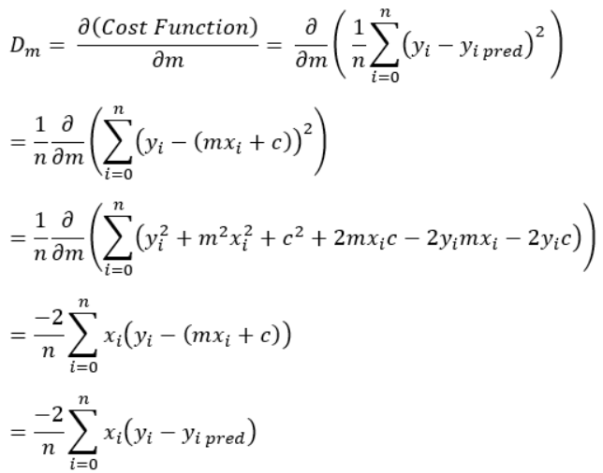
Calculate the partial derivative of the Cost function with respect to m. Let partial derivative of the Cost function with respect to m be D_{m} (With little change in m how much Cost function changes).

Slide 37
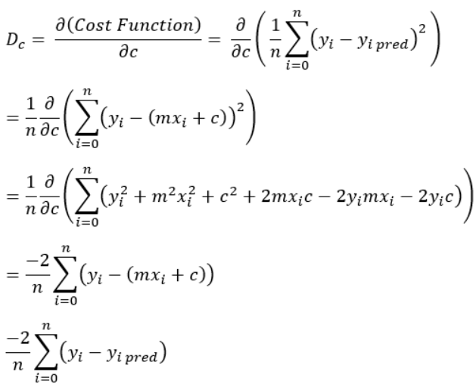
Similarly, let’s find the partial derivative with respect to c. Let partial derivative of the Cost function with respect to c be D_{c} (With little change in c how much Cost function
changes).

Slide 38
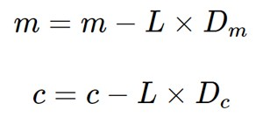
3.Now we update the current value of m and c using the following equation:
Here, L is learning rate which corresponds to how large a step to take. To reach a local minimum efficiently, we have to set our learning rate- parameter α appropriately, neither too high nor too low. Depending on where the initial point starts on the graph, it could end up at different points. Typically, the value of the learning rate is chosen manually, starting with 0.1, 0.01, or 0.001 as the common values.

Slide 39
4. We repeat this process until our loss function is a very small value or ideally 0 (which means 0 error or 100% accuracy).
Hence, to solve for the gradient at the next step of the iteration, we iterate through our data points using our updated m and c values and compute their partial derivatives. This new gradient tells us the slope of our cost function at our current position and the direction we should move to update our parameters
The process of finding the optimal values for m and c is to then minimize our derivatives.
Now with the optimum value of m and c our model is ready to make predictions !

Slide 40
Pros and cons of gradient descent
A simple algorithm that is easy to implement and each iteration is cheap; we just need to compute a gradient
However, it’s often slow because many interesting problems are not strongly convex
Cannot handle non-differentiable functions (biggest downside)

